Slide 1
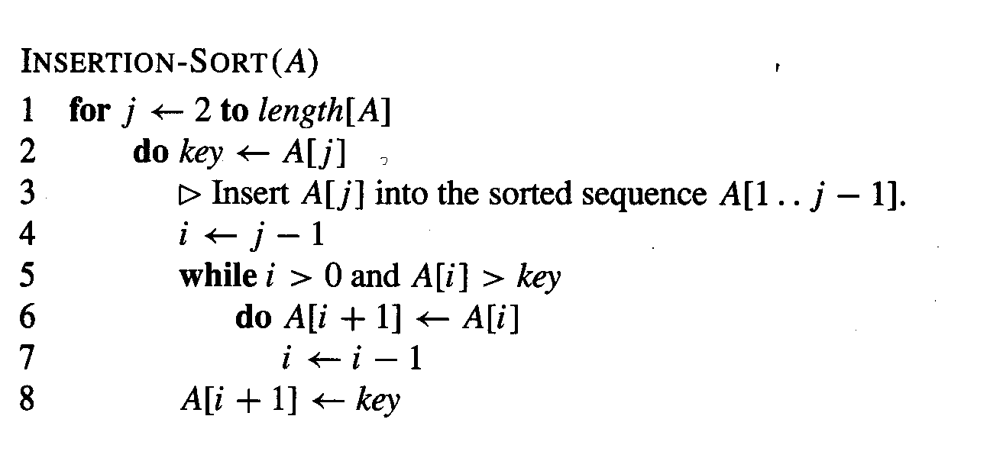
We have to change the comparison in line 5 for reversing the order …
<

